Slide 1
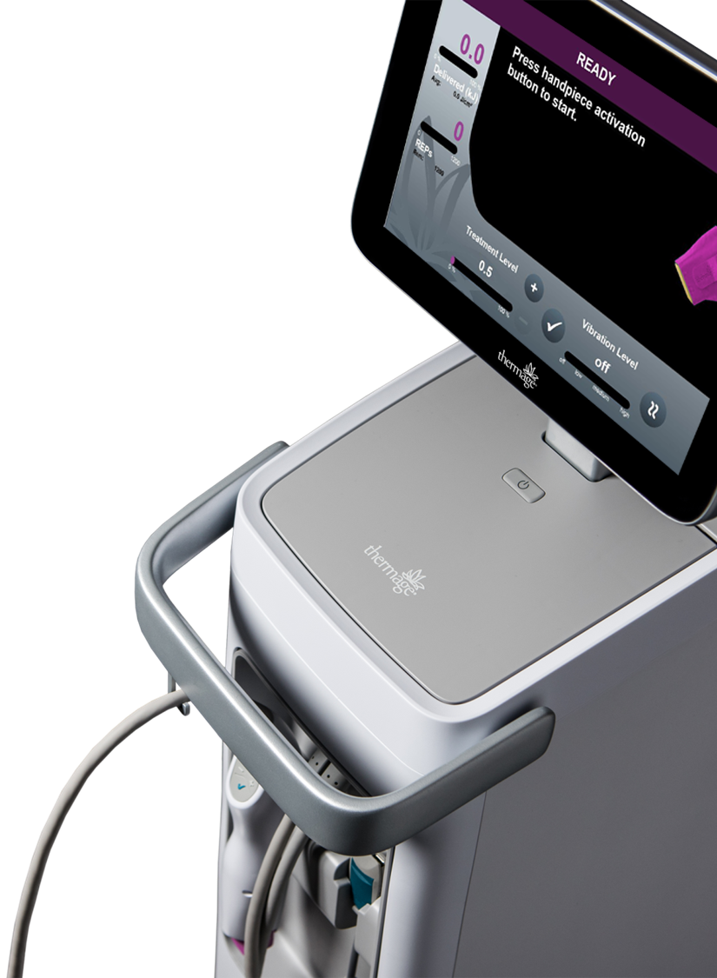
speed | efficacy | comfort
Installation Presentation

Slide 2
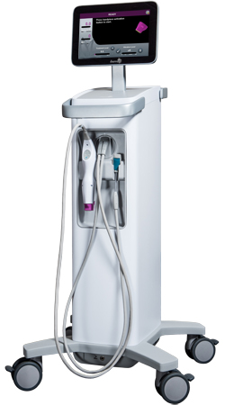
Introduction
The Thermage FLX™ system is a capacitively-coupled radiofrequency device indicated for non-invasive wrinkle-reduction procedures
It is intended to be operated by a trained healthcare professional
This training presentation provides only a general overview of the system and instructions for use
Read the user manual in its entirety before using the system, accessories, components, or performing a Thermage® procedure
Contact Solta Medical product support, a local representative, or an authorized distributor for installation of the system

Slide 3
Important Information
Do not use the Thermage FLX™ system in patients with cardiac pacemakers or other active implants
Improper use may cause personal injury or damage to the system (see the user manual for detailed directions, proper use, and full risk and safety information)
Do not use the system in the presence of flammable anesthetics, other flammable gases, near flammable fluids (e.g. skin preparation agents and tinctures), flammable objects, or with oxidizing agents
Observe appropriate fire precautions at all times
Do not use the system in an oxygen-enriched atmosphere or in the presence of nitrous oxide (N₂O)
Do not use system near critical life-support equipment
Place monitoring electrodes such as ECG/EKG equipment as far as possible from treatment area when monitoring equipment & system are used simultaneously on the patient
Use of monitoring systems incorporating high frequency current-limiting devices is recommended

Slide 4
System overview

Slide 5
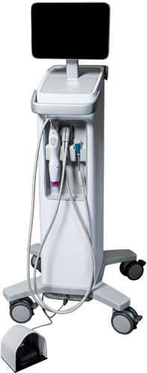
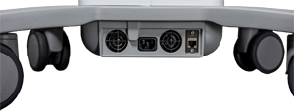
System Overview Thermage FLX™ System Diagram
Touchscreen
Cryogen & USB port compartment
Power button
Handpiece connector
Return pad clip
Handpiece
Treatment tip
Back of System
Footswitch inlet
AC power inlet
and network connection
Footswitch (optional)

Slide 6
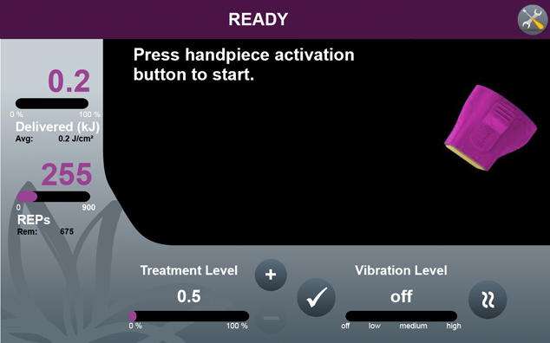
System Overview Touchscreen Controls Diagram
System status bar
System tool button
Energy delivered status
Tip selection
display
RF Energy Pulse (REP) status
Vibration level adjustment
Treatment level indicator
Treatment level adjustment
Continue button

Slide 7
System Overview System Status Messages
Status messages are displayed on upper portion of touchscreen to indicate current state of system
ACTION REQUIRED
System initialization completed
READY
All required components are connected
ARMED
System has detected proper tip-to-skin contact
ACTIVE
Activation button has been depressed; system delivers REP
REP COMPLETE
Release activation button and lift handpiece
ADJUST LEVEL
Treatment Level Adjustment button has been depressed; adjust to desired setting and press Continue button

Slide 8
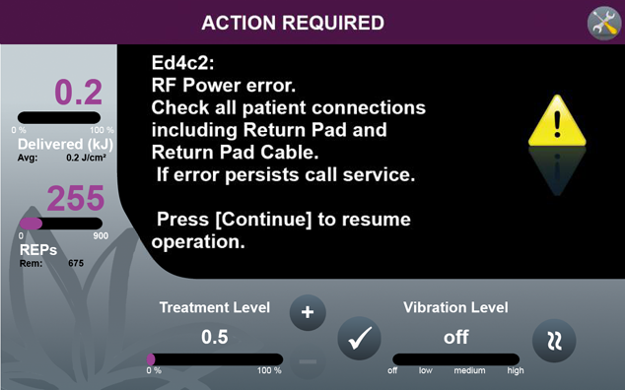
System Overview Error Codes/Messages
Error code number & instructions

Slide 9
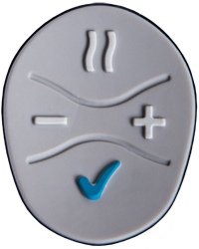
System Overview Thermage FLX™ Handpiece Diagram
Vibration level adjustment
Treatment level adjustment
Continue button
Activation button
Treatment tip

Slide 10
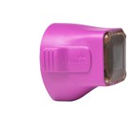
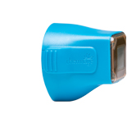
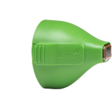
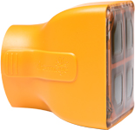
System Overview Treatment Tips (Not Backwards Compatible)
Total Tip 4.0 cm² for treatments on- and off-face
TT4.00F6-XXX (300, 600, and 900 REP counts)
Total Tip 3.0 cm² for treatments on- and off-face
TT3.00F6-XXX (400, 600, 900, and 1200 REP counts)
Eye Tip 0.25cm² for treatments over the eye*
TT0.25F6-XXX (225 and 450 REP counts)
Body Tip 16.0 cm² for treatments on the body
TT16.00F6-XXX (500 REP count)
*Used with plastic ocular shields

Slide 11
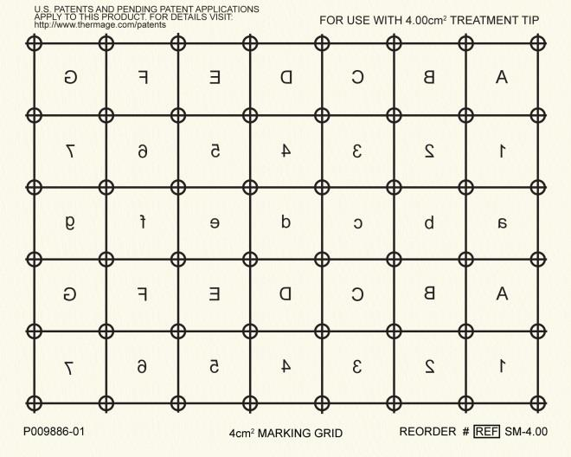
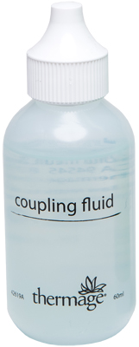
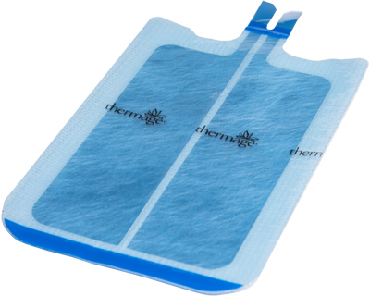
System Overview System Accessories
Use only Solta-supplied accessories
Important:
Cryogen
Canister
(TC-2-4)
Coupling Fluid*
(TF-2-30, TF-2-60)
Patient Return Pad
(TR-4)
Skin Marking Paper**
(SM-0.25, SM-3.00,
SM-3.00L, SM-4.00,
SM-4.00L, SM-16.00)
*Available in 30 ml or 60 ml bottles
**Skin marking paper sizes correspond with treatment tip sizes

Slide 12
System setup

Slide 13
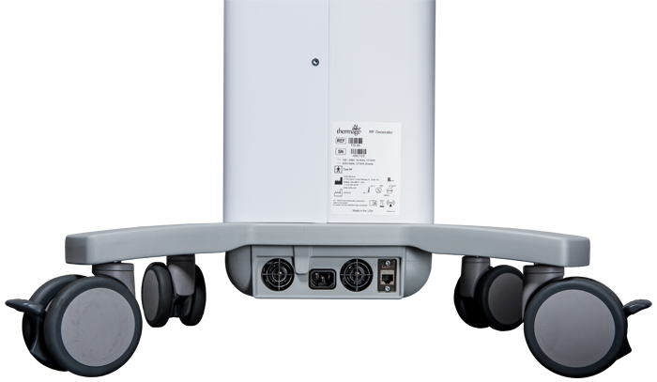
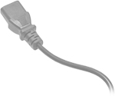
System Setup Power Cable Installation
AC power cord should only be connected to a supply mains with protective earth (i.e. a grounded outlet). Extension cords and/or adapter plugs must not be used.
Connect AC power cord to inlet
Note:

Slide 14
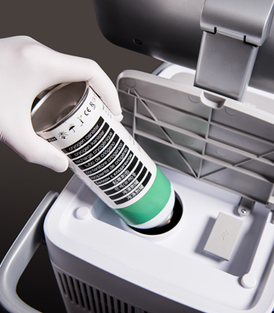
System Setup Cryogen Canister Installation
Lift compartment lid located behind Touchscreen
Invert Cryogen Canister so connector is pointing downward
Insert canister into port and rotate clockwise until resistance is met
Do not over tighten
Typically 3 complete rotations
Close compartment lid
Replace canister when System displays “EMPTY” message
Cryogen utilization will be faster with the Thermage FLX™ system as compared to the Thermage CPT system.
Note:

Slide 15
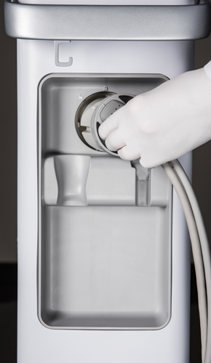
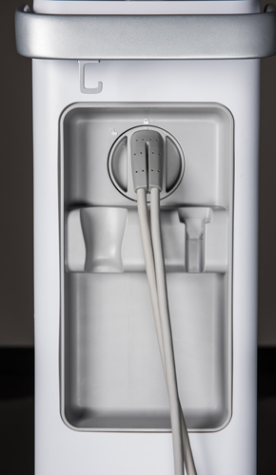
System Setup Handpiece Installation
Align to “unlocked” position
and insert connector
Rotate to “locked” position

Slide 16
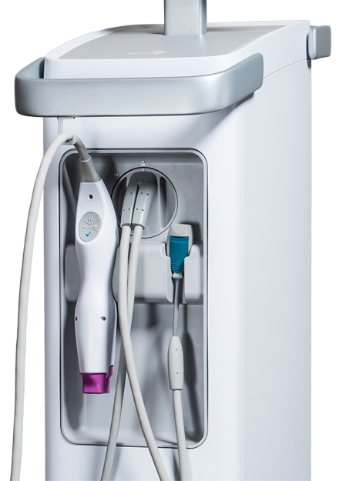
System Setup Handpiece Storage
Handpiece cable management & support hook
Magnetic handpiece cradle
Return pad clip cradle

Slide 17
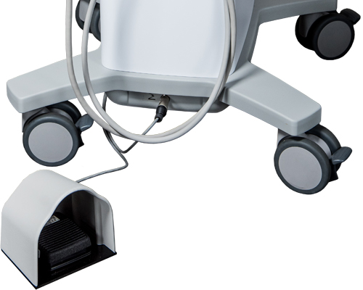
System Setup Footswitch Installation (Optional)
Connect footswitch cord to inlet
Handpiece treatment activation is disabled when footswitch is attached. To enable handpiece activation, disconnect footswitch.
Footswitch
(optional)
Note:

Slide 18
System Setup Configure System: System Tools
1
Screen Lock
Temporarily locks touchscreen; tap “System Tools” button to unlock
Language
Choose display language; reboot to use newly selected language
Main Volume
Adjust volume for “event” tones
RF Volume
Adjust volume for “energy delivery” tone
Sound Style
Choose style of audible tones
Training Mode
No energy/cryogen delivered; no treatment progress bar
To exit, restart system and verify “Training Mode” no longer displayed
Retrieve Logs
Solta Medical service engineer or authorized personnel use only
System Default
Return system to default settings
Tip Summary
Displays tip summary data of current treatment tip
About
View system information (e.g. serial number and software version)
Press System Tools button to access menu and adjust desired settings
2
Press Back button to return to previous menu/exit
System Tools menu (select desired function and follow prompts)
Back/Menu Exit Button

Slide 19
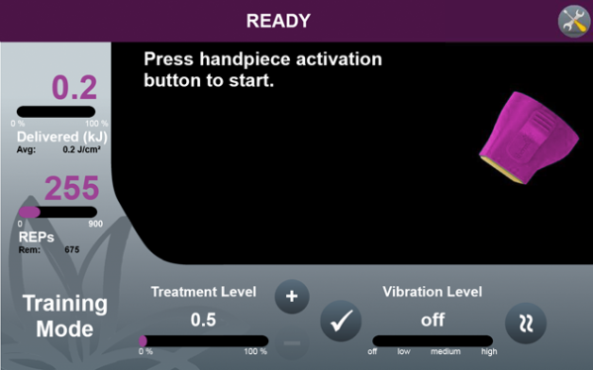
System Setup System Tools: Training Mode
Allows for mock procedure training
No RF energy delivered
No cryogen delivered
Treatment progress bar does not function
Verify “Training Mode” is displayed on screen
To exit Training Mode, power system off then on
Verify that “Training Mode” is no longer displayed
Training mode indicator

Slide 20
Procedure overview

Slide 21
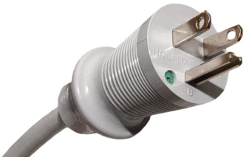
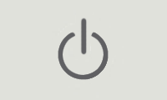
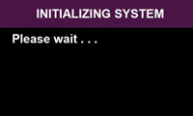
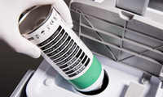
Procedure Overview Pre-Treatment: System Preparation
1
Plug in power cord and position system
Connect power cord to hospital-grade grounded electrical outlet
DO NOT use extension cords or adapter plugs
Allow at least 10 inches (25 cm) space on all sides of console
2
Power on system
Power button on top of console in front of touchscreen should illuminate blue; press button to turn system on
The power button serves to turn on, turn off, and restart the system
3
Follow on-screen prompts to proceed
4
Check cryogen level (replace if needed)
Replace cryogen canister when system displays “EMPTY” message
DO NOT overtighten canister during installation/replacement
Recommend having backup canister available at all times

Slide 22
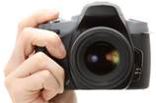
Procedure Overview Pre-Treatment: Patient Preparation
1
Set appropriate expectations in consultation
2
Have patient sign consent form
3
Remove makeup, lotion, and jewelry
Cleanse treatment area and degrease with alcohol
Areas that undergo treatment or have a return pad attached should be free of hair
4
Take “before” photos (e.g. Front, 45°R, 45°L)
Check distance, vertical tilt and horizontal rotation
For face, align tip of nose with edge of cheek; gaze is eye level
Ensure consistent lighting/positioning with eventual “after” photos

Slide 23
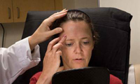
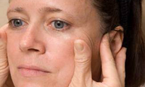
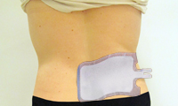
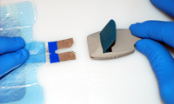
Procedure Overview Pre-Treatment: Patient Preparation
5
Patient assessment
Ask patient to identify areas of concern/treatment goals
6
Define treatment areas
Palpate skin/tissue for mobility, firmness and thickness to identify areas of treatment and determine treatment plan
7
Apply return pad to patient (e.g. lower back)
Utilize well-vascularized area; do not place near shoulder, neck, or head
Clean with alcohol and allow to dry completely
Ensure entire return pad is contacting patient’s skin & area is free of hair
8
Connect return pad to return pad cable
Lift clamp on return pad cable and insert return pad tab into connector
Close clamp and verify connection is secure

Slide 24
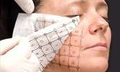
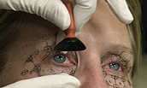
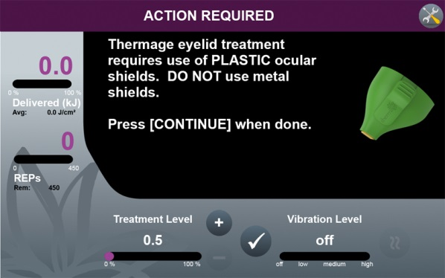
Procedure Overview Pre-Treatment: Patient Preparation
9
Position patient for treatment
Adjust treatment table/chair based on area being treated
Ensure gloves are worn on both hands during the treatment
10
Apply marking paper to treatment area
Ensure the grid size which matches the tip size is selected
Recommend using 70% isopropyl alcohol and alcohol swab
11
Insert eye shields (if applicable)
DO NOT use metal eye shields; use plastic eye shields only

Slide 25
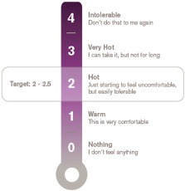
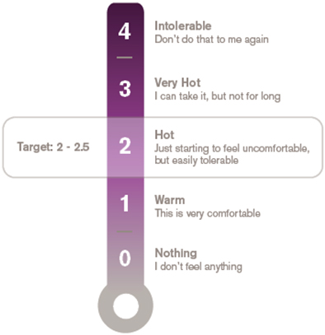
Procedure Overview Pre-Treatment: Patient Preparation
12
Familiarize patient with feedback scale
Used to determine patient perception of heat and comfort level during treatment
DO NOT use local anesthesia or pain-blocking techniques

Slide 26
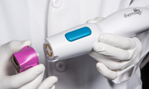
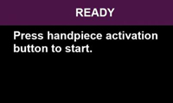
Procedure Overview Treatment
1
Select treatment tip
Select appropriate tip and REP count based on treatment area, size, and anticipated number of passes/vectors
2
Clean treatment tip
Wipe treatment tip with 70% isopropyl alcohol to clean
Inspect tip membrane for damage or contamination
DO NOT use a tip showing signs of damage or contamination
3
Attach treatment tip to handpiece
Align and press treatment tip into handpiece until resistance is met
Treatment tip information should display on touchscreen
4
Confirm system status displays “READY”
System should display “READY” on status bar when all required components are connected and until activation button on handpiece or footswitch is pressed

Slide 27
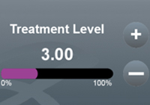
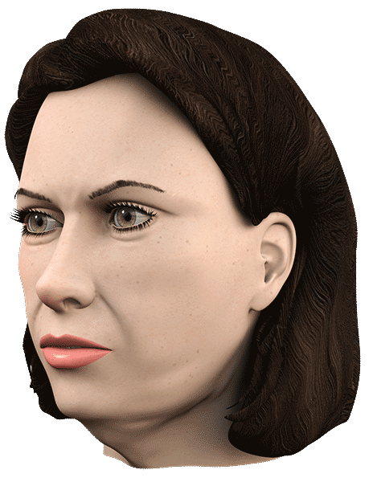
Procedure Overview Treatment
5
Select treatment level
Typical starting treatment level is 3.0 (2.0 for 0.25cm² tip)
Adjust treatment level based on patient feedback during procedure
Prior to increasing treatment level, check that the Return Pad has full contact with the patient and Return Pad cable connectors are secure.
Common Sensitive Areas

Slide 28
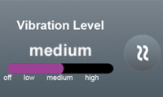
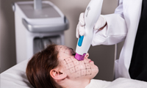
Procedure Overview Treatment
6
Select handpiece vibration level
Vibration may improve patient comfort
Use patient feedback to adjust vibration settings during treatment
DO NOT use vibration on or around eye with eye shields inserted
7
Apply coupling fluid to treatment site
Use only Solta-supplied coupling fluid
Regularly reapply more coupling media as needed during treatment
Use approximately one 60 mL bottle for a 900 pulse treatment
8
Perform initial “super-pass” treatment
Maintain proper “stamping” technique; DO NOT “slide treat” or stack pulses
If REP is interrupted, release activation button and maintain tip-to-tissue contact to ensure post-cooling occurs prior to resuming treatment
Pre-Cooling
System supplies cryogen to tip
RF Delivery
System tunes and delivers treatment REP
Post-Cooling
System supplies cryogen to tip

Slide 29
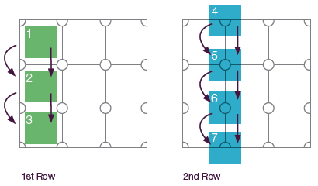
Procedure Overview Treatment
SUPER-
PASS
Alternate complete rows of treatment pulses
One row of squares followed by next row of circles, etc.
Monitor skin temperature with non-treating hand and treat another area before returning to site if tissue is hot-to-the-touch
Treat consecutive pass sites before returning to first site of a pass to allow a cooling interval. Do not stack REPs.
Note:

Slide 30
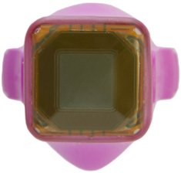
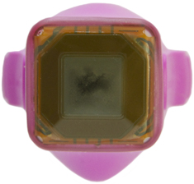
Procedure Overview Treatment
TIP CHECK
Routinely inspect tip surface for irregularities
Inspect/feel tip for any physical damage to electrode surface
If imperfections are found (e.g. membrane breaches) immediately stop treatment and replace with new tip; return affected tip to Solta immediately
Normal electrode surface (no irregularities)
Abnormal electrode surface (pin-hole breach)
Abnormal electrode surface (dielectric breakdown)

Slide 31
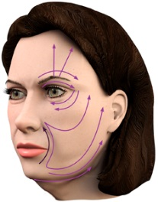
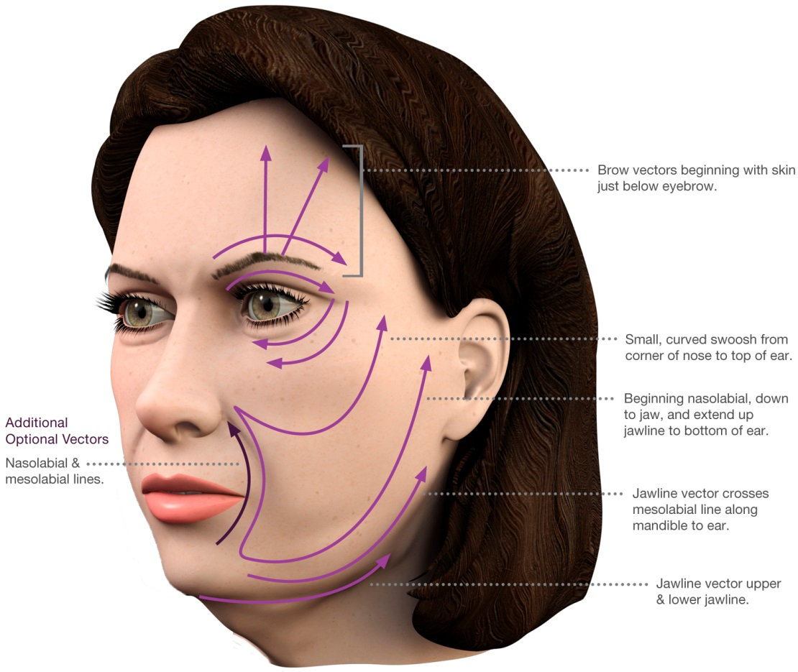
Procedure Overview Treatment
9
Perform vector and problem area passes
After initial treatment passes, perform minimum of 5-10 additional passes focusing on vectors and/or “problem” areas
Recommend using all available tip REPs during treatment

Slide 32
Procedure Overview Post-Treatment and Follow-Up
1
Remove grid from skin
Wipe treatment area to remove coupling fluid
Remove skin marking grid using 70% isopropyl alcohol, followed by mild soap and warm water
2
Disconnect and dispose of return pad
Disconnect from cable connector and gently remove pad from skin
DO NOT reuse return pad and discard in accordance with applicable laws/regulations
3
Disconnect and dispose of treatment tip
Grasp along sides of tip and pull away from handpiece
DO NOT reuse treatment tip and discard in accordance with applicable laws/regulations
4
Power off system
Press power button on top of console in front of Touchscreen and follow instructions

Slide 33
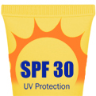
Procedure Overview Post-Treatment and Follow-Up
5
Clean system and system accessories
Clean all system surfaces/cables and accessories at end of each treatment using isopropyl alcohol or damp cloth
Use care when cleaning handpiece to avoid damaging components
6
Resume normal skincare regimen
No special after care is required
Recommend using broad spectrum SPF 30 or higher
7
Follow-ups: 2, 4, and 6-8 months
“After” photos should follow same guidelines as “before” photos
Use consistent distance, positioning and lighting
Have “before” photos available for reference

Slide 34
INDICATION
The radiofrequency energy only delivery components of the Thermage FLX™ system and accessories are indicated for use in:
Non-invasive treatment of periorbital wrinkles and rhytids including upper and lower eyelids; and
Non-invasive treatment of wrinkles and rhytids.
The simultaneous application of radiofrequency energy and skin vibration by the Thermage FLX system and accessories are indicated for use in:
Non-invasive treatment of periorbital wrinkles and rhytids;
Non-invasive treatment of wrinkles and rhytids; and
Temporary improvement in the appearance of cellulite.
IMPORTANT SAFETY INFORMATION
Do not use the Thermage FLX system in patients with cardiac pacemakers or other active implants.
Improper use of the Thermage FLX system may cause personal injury or damage to the system. See the Technical User’s Manual for detailed directions, proper use, and full risk and safety information.
®/TM are trademarks of Valeant Pharmaceuticals International, Inc. or its affiliates. Any other products/brand names and/or logos are trademarks of the respective owners. TRM.0171.USA.17
© 2017 Valeant Pharmaceuticals North America LLC

